Slide 1
Computer Networks
CSE405
Data Link Layer
Rabea Khatun
Lecturer
Dept. Of CSE
East West University

Slide 2
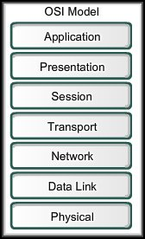
Data Link Layer
Basic functions:
Framing.
Flow Control
MAC Addressing
Controls how data is placed on the media and received from the media using media access control (MAC) and
error detection.

Slide 3
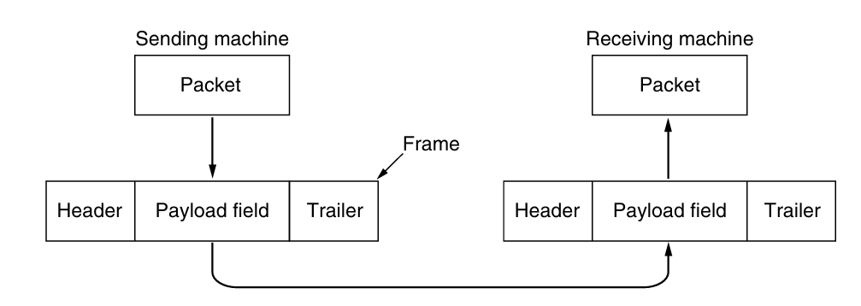
Framing
The data link layer takes the packets it gets from the network layer and
Encapsulates them into frames for transmission.
Each frame contains a frame header, a payload field for holding the packet, and a frame trailer, as illustrated in Fig.

Slide 4
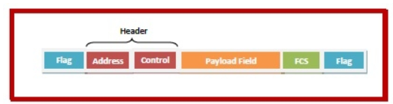
Fields of a Data Link Layer Frame
A data link layer frame has the following parts:
Frame Header: It contains the source and the destination addresses of the frame and the control bytes.
Payload field: It contains the message to be delivered.
Trailer: It contains the error detection and error correction bits. It is also called a Frame Check Sequence (FCS).
Flag: Two flag at the two ends mark the beginning and the end of the frame.

Slide 5
Frame Header
A frame header contains the destination address, the source address and three control fields kind, seq, and ack serving the following purposes:
kind: This field states whether the frame is a data frame or it is used for control functions like error and flow control or link management etc.
seq: This contains the sequence number of the frame for rearrangement of out – of – sequence frames and sending acknowledgments by the receiver.
ack: This contains the acknowledgment number of some frame, particularly when piggybacking is used.

Slide 6
Stuffing
The data frames can be of fixed length or variable length.
In variable – length framing, the size of each frame to be transmitted may be different.
So, a pattern of bits is used as a delimiter to mark the end of one frame and the beginning of the next frame. However, if the pattern occurs in the message, then mechanisms needs to be incorporated so that this situation is avoided.

Slide 7
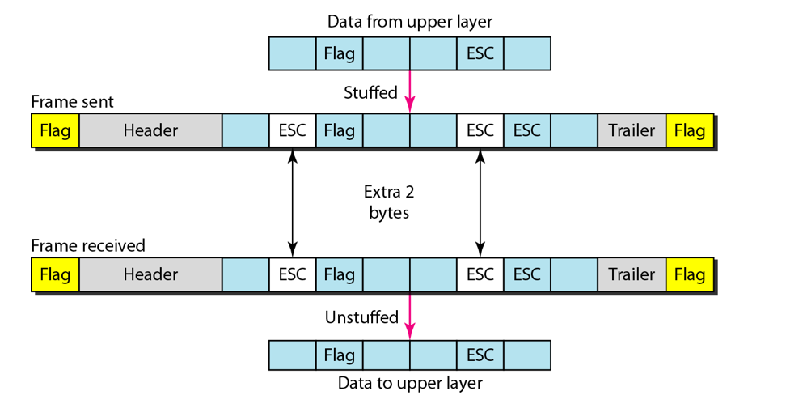
Byte Stuffing
In byte stuffing, a special byte called the escape character (ESC) is stuffed before every byte in the message with the same pattern as the flag byte. If the ESC sequence is found in the message byte, then another ESC byte is stuffed before it.
A B FLAG C ESC D
A B ESC FLAG C ESC ESC D

Slide 8
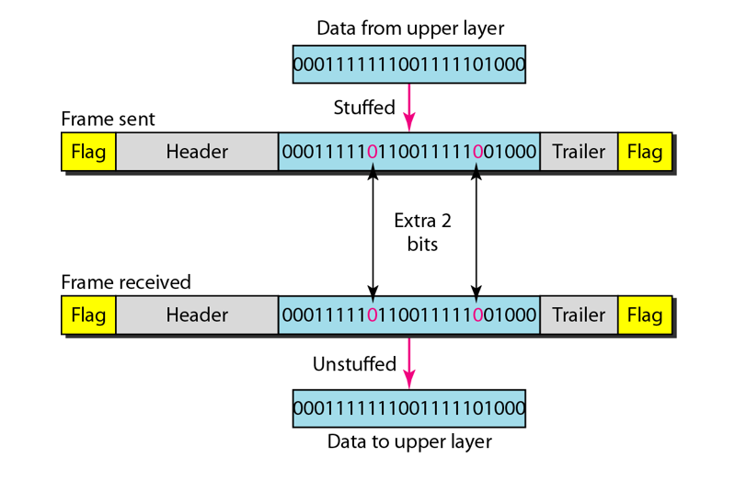
Bit Stuffing
Bit stuffing is the process of adding one extra 0 whenever five consecutive 1s follow a 0 in the data, so that the receiver does not mistake the pattern 0111110 for a flag.
fixed bit pattern (01111110) as a flag
01111101111110
0111110 0 111110

